Slide 1
BYU Marriott
School of Business
Student Academic Association
& Club Orientation
September 26, 2017
BYU Marriott School of Business

Slide 2
Today’s Menu
Opening Prayer
Introduction of PDF and Student Council Leadership
Introduction of Dean Thompson and Eric Teel
  Annual Re-chartering of Clubs
  BYU and BYU Marriott Club Organization
  Support Structure
    The Role of Your Advisor
    Key Contacts: “Who to Call”
    University Contacts
  Key Policies & Best Practices
Upcoming Events – Student Council
Closing Prayer
A copy of this presentation can be found here:
https://marriottschool.byu.edu/policies/clubs/
BYU Marriott School of Business

Slide 3
The BYU Marriott
Professional Development Forum welcomes you to a new school year!
BYU Marriott School of Business

Slide 4
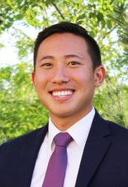
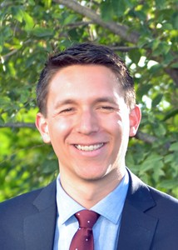
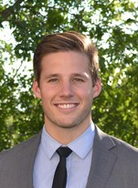
2017 Student Council Leadership
George Choi
Student Council
President
Cade McGary
Student Council
Vice President
Aaron Rowan
Student Council
Vice President
BYU Marriott School of Business

Slide 5
Annual Re-Chartering
Every club must re-charter annually.
All clubs MUST login to
https://clubs.byu.edu/
and re-charter during their anniversary month. This orientation / training
is a required part of re-chartering.
BYU Marriott School of Business

Slide 6


BYU Clubs Organization
https://clubs.byu.edu/
Special Interest / Social Clubs
Linked to
Academic Program or Department
Academic
Associations
BYU Marriott School of Business

Slide 7
BYU Marriott Club Structure
Three Types
College Serviced Clubs / Associations
Program/Dept/ Center
Serviced Clubs / Associations
BYUSA or Other College Serviced Clubs / Associations
1
2
3
The administrative support structure varies depending on the type of club.
BYU Marriott School of Business

Slide 8
BYU Marriott Club Structure
1
College Serviced Clubs/Associations
  Undergraduate associations
  Focused on career development
  Program/major aligned, or college sponsored (pre-management or diversity initiative based
  Open membership (non-MSB students may join)
  Presidents of these clubs make up the college Professional Development Forum (PDF)
BYU Marriott School of Business

Slide 9
BYU Marriott Club Structure
Accounting Society (and sub-clubs)
ALPFA
Association for Information Systems
Business Strategy Club
Entrepreneurship Association
Event & Venue Management Club
Finance Society (and sub-clubs)
Global Supply Chain Association
Management Consulting Club
Marketing Association
Non-Profit Student Association
Pre-Management Association (PreMa)
Society for Human Resource Management
Therapeutic Recreation Club
Women in Business Club
BYU Marriott School of Business

Slide 10
BYU Marriott Club Structure
2
Program/Department/Center Serviced Clubs/Associations
  Any graduate clubs, or any other undergraduate clubs, serviced/supported by a BYU Marriott Program, Department or Center
BYU Marriott School of Business

Slide 11
BYU Marriott Club Structure
MBA
MBA Assoc
MBA Marketing Assoc
MBA Analytics Club
MBA Strategy & Consulting Club
MBA Tech Society
MBA Adam Smith Society
Women in Management
Graduate Entrepreneur Assoc
Graduate Finance Assoc
Graduate Real Estate Assoc
Graduate Supply Chain Mgmt Assoc
Healthcare Industry Assoc
Graduate HR Student Assoc
Automotive Industry Club
MPA
MPA Association
Internat’l City/County Mgmt Assoc
CENTERS
Ballard Center Student Assoc
Changemaker Club
Graduates for Social Innovation
Global Mgmt Student Assoc
Internat’l Grad Student Assoc
China Business Club
Korean Business Student Asso
OTHER
Army ROTC Club
Healthcare Mgmt Assoc
BYU Marriott School of Business

Slide 12
BYU Marriott Club Structure
3
BYUSA or Other College Serviced Clubs/Associations
  All other business related clubs that are not sponsored by BYU Marriott or a BYU Marriott Program, Department or Center
BYU Marriott School of Business

Slide 13
BYU Marriott Club Structure
Armenian Business Student Assoc (BYUSA)
Business in Health Professions (Life Science)
BYU Analytics Club (Physical/Mathematical Science)
BYU Data Science Club (Physical/Mathematical Science)
BYU Tech Club (BYUSA)
BYU Veterans Club (BYUSA)
Engineers Mean Business Club (BYUSA)
Entrepreneurship Association / e-Club (BYUSA)
Humanities to Business Club (BYUSA)
Venture Factory (Engineering/Technology)
Etc.
BYU Marriott School of Business

Slide 14

Your Support Team
BYU Marriott School of Business

Slide 15
The Role of Your Advisor
Assists in developing club goals and objectives
Regularly attends club meetings and events
Reviews monthly financial reports provided by the university and maintains awareness of club’s financial status
Understands university and college club policies and procedures
Ensures the club and its officers know how to access club policies and procedures, and that they are followed

Slide 16
Key Contacts: “Who to Call”
1
2
3
College Serviced
Program, Department or Center Serviced
All Other
FIRST CONTACT (after Advisor)
Business Career Center
-----------------------
Designated Contact
Center, Program or Department
----------------------
Dept/Financial Administrator
BYUSA or
Assoc Academic
VP Office
----------------------
Kirsten Thompson
BYU Marriott School of Business

Slide 17
Other Key BYU Marriott Contacts
(BCC and Dept liaisons will pull these experts in as needed)
Name | Role | Contact
Michael Thompson, Associate Dean | Associate Dean – Policy/Oversight | Michael.Thompson@byu.edu
LuAnn Hart | Dean Thompson’s Assistant | luannhart@byu.edu
Robert Gardner, Assistant Dean | External relations, web-related issues | rgg@byu.edu
Eric Teel, College Controller | Fundraising | ericteel@byu.edu
Pamela Castillo, Associate Controller | Financial and compliance issues | Pamela_Castillo@byu.edu
Nicole Kooistra, College Events Mgr | Special events, scheduling, speakers | Nicole_Kooistra@byu.edu
Idon Openshaw, Events Coordinator | Special events, scheduling, speakers | Idon_openshaw@byu.edu
Rixa Oman, Assistant to the Dean | Facilities management and Mgmt Society | rixa@byu.edu
BYU Marriott School of Business

Slide 18

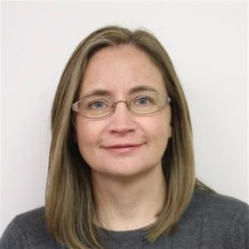
BYU Club Support
https://clubs.byu.edu/
Academic
Associations
Academic VP Office, D-380 ASB
Brigham Young University, Provo, Utah 84602
Phone: (801) 422-4331
Email: kirsten_thompson@byu.edu
3400 Wilkinson Student Center (WSC)
Brigham Young University, Provo, Utah 84602
Phone: (801) 422-7339
clubsandorgs@byu.edu
Kirsten Thompson
Assistant to Associate
Academic Vice President
BYU Marriott School of Business

Slide 19

Key Policies: “How Do I….”
University Policies & Procedures
Mosiah 4:29 = the need for your “Who to Call” contacts
“And finally, I cannot tell you all the things whereby ye may commit sin; for there are divers ways and means, even so many that I cannot number them.”
BYU Marriott School of Business

Slide 20
How do I….buy something?
SEE “WHO TO CALL” PAGE
Review “Disbursing Funds” on the Club Policies & Procedures page: https://marriottschool.byu.edu/policies/clubs/
DO check out a Campus Card or Department Card
DO NOT use personal funds/credit card
DO NOT purchase gift cards without going through Treasury
DO NOT purchase expensive door prizes or awards ($100 limit)
DO NOT hire an individual or company to provide services (without the assistance of your “Who to Call” contact)

Slide 21
How do I….raise money?
SEE “WHO TO CALL” PAGE
Review “Incoming Funds” on the Club Policies & Procedures page: https://marriottschool.byu.edu/policies/clubs/
Primary funding source is student dues
If student dues are insufficient the sponsoring department should discuss budget shortfalls and consider providing a supplement.
Additional fundraising may only be performed to meet reasonable operating expenses, but not to build up financial reserves.
Before approaching any company or individual to solicit donations it must be cleared with LDS Philanthropies.

Slide 22
How do I….set up a club website?
SEE “WHO TO CALL” PAGE
College serviced clubs: CareerLaunch
Program/Department/Center serviced clubs: Students may create their own (and link to BYU Marriott website). The BYU Marriott Web Team can assist:
  Go to marriottschool.byu.edu
  Click the “IT Support” link through your tools dropdown or at the page footer
  Click the “Submit a Ticket” link
  Select the “Website Support” option and click “Next”
  Fill out your name and details and click “Submit” and you will be contacted shortly about your request.

Slide 23
How do I….manage my membership?
SEE “WHO TO CALL” PAGE
“Club Administration” link on BYU Marriott website:
  All club officers have access
  Change information about your club that is displayed on BYU Marriott site
  Provide link to club website
  Update dues information
  View/edit membership roster
  Add web Administrators (give them an Officer Title)
  Etc.

Slide 24
How do I….buy swag?
SEE “WHO TO CALL” PAGE
Marriott School merchandise:
  www.byustore.com / BYU eStores / BYU Marriott
T-Shirts:
  Y-Marketplace (your “Who to Call” contact can help)
  BYU Print & Mail
Logos and designs
  BYU and Marriott School trademarks and logos are protected. All new club logos must be approved by the BYU Marriott External Relations Office (490 TNRB) and the university (email to front.desk@byu.edu).

Slide 25
How do I….travel as a club?
SEE “WHO TO CALL” PAGE
Review “Travel” on the Club Policies & Procedures page: https://marriottschool.byu.edu/policies/clubs/
In short: Don’t! ☺ Student travel must be sponsored by a department, center or course; cannot be “club” travel.
No club dues can be used to pay for travel expenses.

Slide 26
How do I….hold an event?
SEE “WHO TO CALL” PAGE – They will help navigate ALL of the following (remember Mosiah 4:29):
  Room scheduling & setup
  Food/catering
  Parking
  Speaker clearance (must be approved by the dean’s office – Idon)
  Waiver forms / risk management
  Building use policies
  Permitted hours
  Advertising
  Etc., etc.
NO red/dark punch anywhere. Report spills promptly! Red Dye #40 prohibited – read labels.

Slide 27
Key Contacts: “Who to Call”
1
2
3
College Serviced
Program, Department or Center Serviced
All Other
FIRST CONTACT (after Advisor)
Business Career Center
-----------------------
Designated Contact
Center, Program or Department
----------------------
Dept/Financial Administrator
BYUSA or
Assoc Academic
VP Office
----------------------
Kirsten Thompson
BYU Marriott School of Business

Slide 28
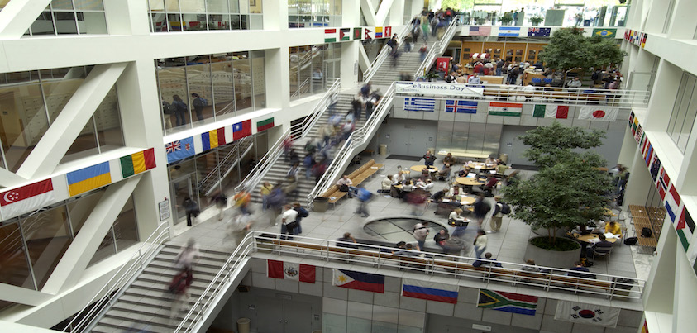
A great year ahead!
BYU Marriott School of Business

Slide 29
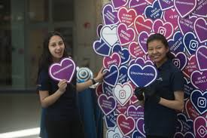
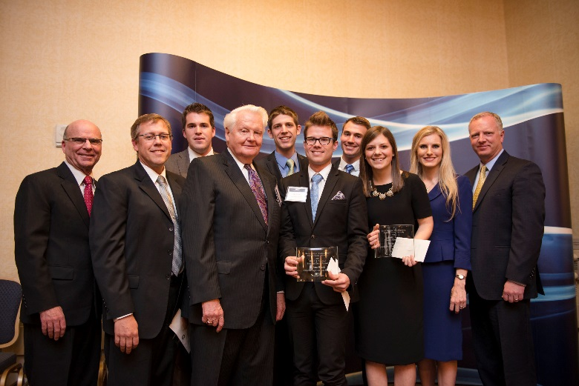
2017-18 Student Council Events
Fall Kick-Off (Thank you for your participation!)
Sub for Santa
Closing Banquet
BYU Marriott School of Business

